Slide 1


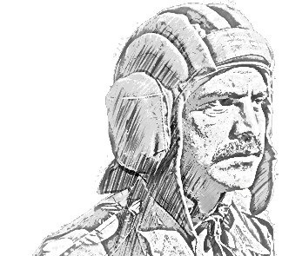

SCHOOL OF TECH TRG
ELECTRONICS WING

Slide 2
AIM
FD REPAIR,EXPEDIENTS, CARE & MAINT

Slide 3
SCOPE
Part No I : Repair Techniques
Part No II : Care and Maintenances

Slide 4
PART NO I : REPAIR TECHNIQUES

Slide 5
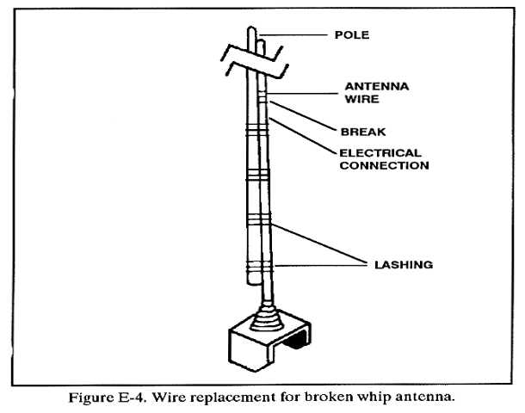
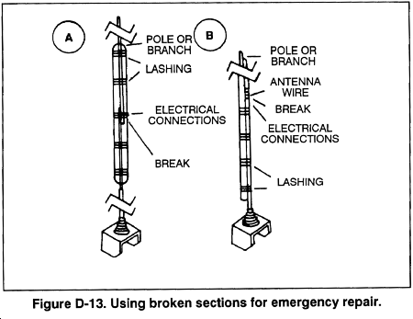
WHIP ANTENNA

Slide 6
WHIP ANTENNA
A whip antenna is an antenna consisting of a straight flexible wire or rod
Name is derived from the whip-like motion that it exhibits when disturbed
Whips are the most common type of monopole antenna (resonant ant), and are used in the higher frequency HF, VHF and UHF radio bands
Like a vertical dipole has an omnidirectional radiation pattern
REPAIR
Remove the paint from the broken end.
Join the broken section- wire or tape around a branch
If whip completely broken - take a wire of same length tie it with antenna base

Slide 7
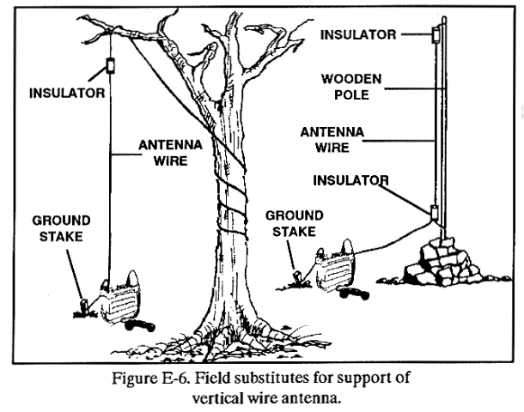
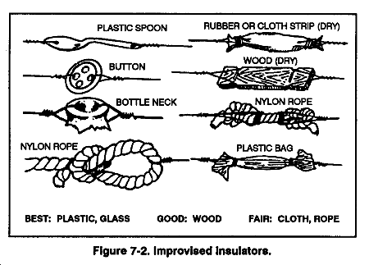
WIRE ANTENNA

Slide 8
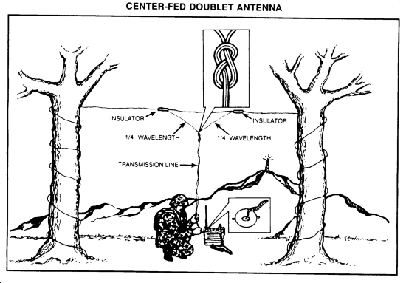
WIRE ANTENNA

Slide 9
WIRE ANTENNA
A random wire antenna is radio antenna consisting of a long wire suspended above the ground, whose length does not bear a relation to the wavelength of the radio waves used (non resonant), but is typically chosen more for convenience
REPAIR
Try repairing wire first
Solder the joints
If changing wire, ensure length is same

Slide 10
ACCESSORIES
GUYS
Used to stabilise ant sp
Manila rope, nylon rope, etc
Rpr - replace rope
MAST
Ant sp by mast
Rpr - replace mast, if long pcs not avlb, overlap short ones

Slide 11
Part No II. Care And Maintenances

Slide 12
Care and Maintenances
(General)
Insulators- cleaned properly, to be checked for cracks
Wire antenna safety loops to be checked
Ensure no HV eqpt or current passing near an ant sys
Always carry a spare wire ant
ATU and the link to main ant - insulated
Before doing antenna maintenance ensure power cable removed and fuses kept properly
Antenna to be kept clean, no salt, dust, etc to be present.
Feeders and brackets to be regularly checked

Slide 13
CARE AND MAINT(AFV)
Antenna to be mounted on antenna mounting base properly
Use of tie down kit
Turn RS off before mounting / dismounting Antenna on Antenna mounting base
Documentation
Always report any breakage

Slide 14

ANY QUESTIONS

Slide 15
FD REPAIR,EXPEDIENTS AND CARE & MAINT

Slide 16

JAI HIND...

